Slide 1
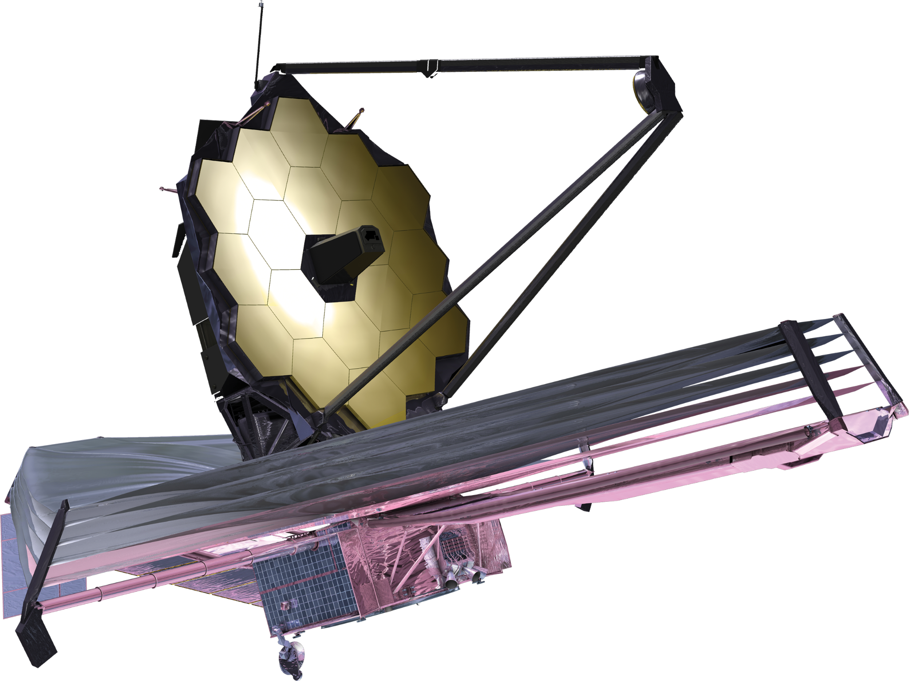
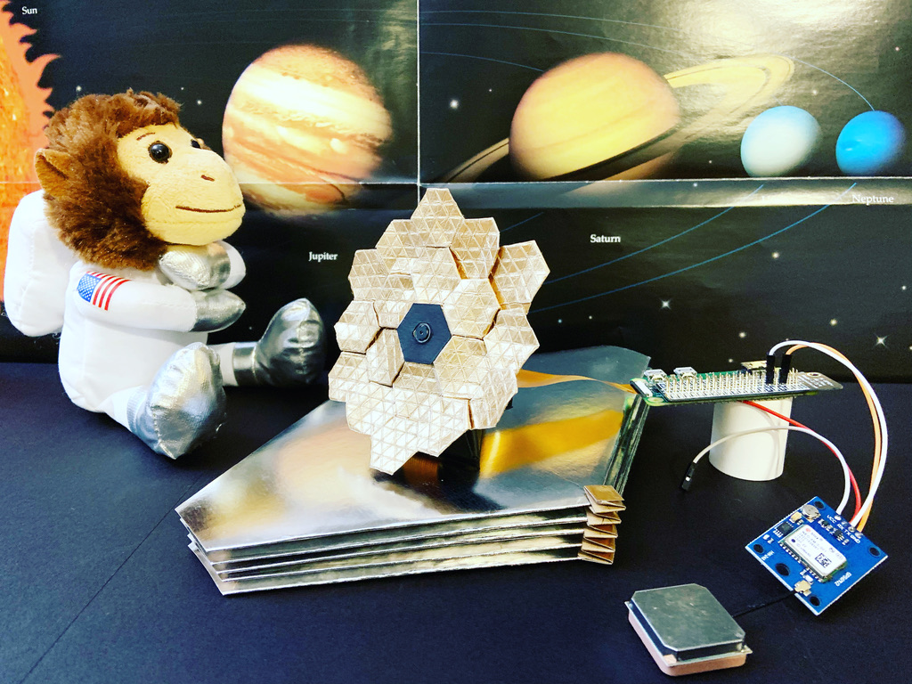

Jimmy in the Box:
Where Paper Crafting Meets Electronics and Coding
Team motto: “Craft, code, and play to learn!”
Webb Origami Design Challenge
Boston, MA, USA
Oct 2 - 3, 2021
Notes:
H

Slide 2

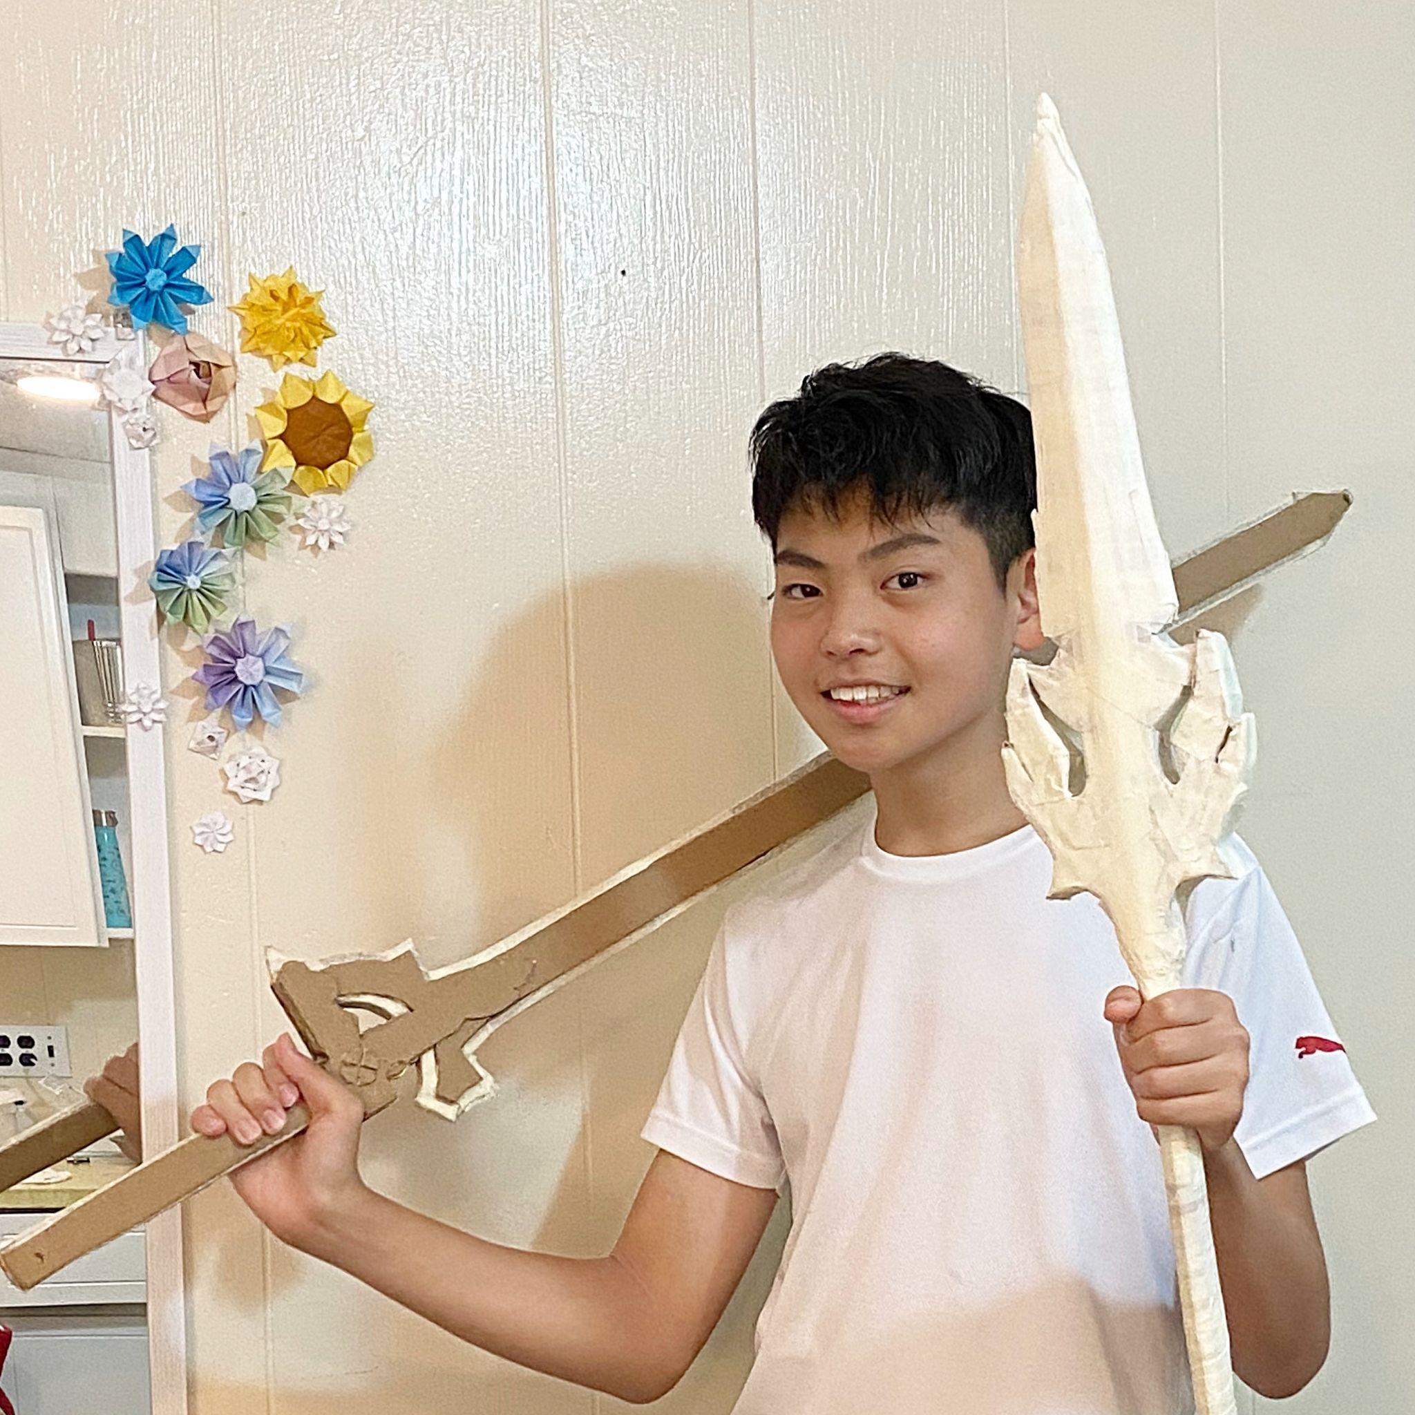

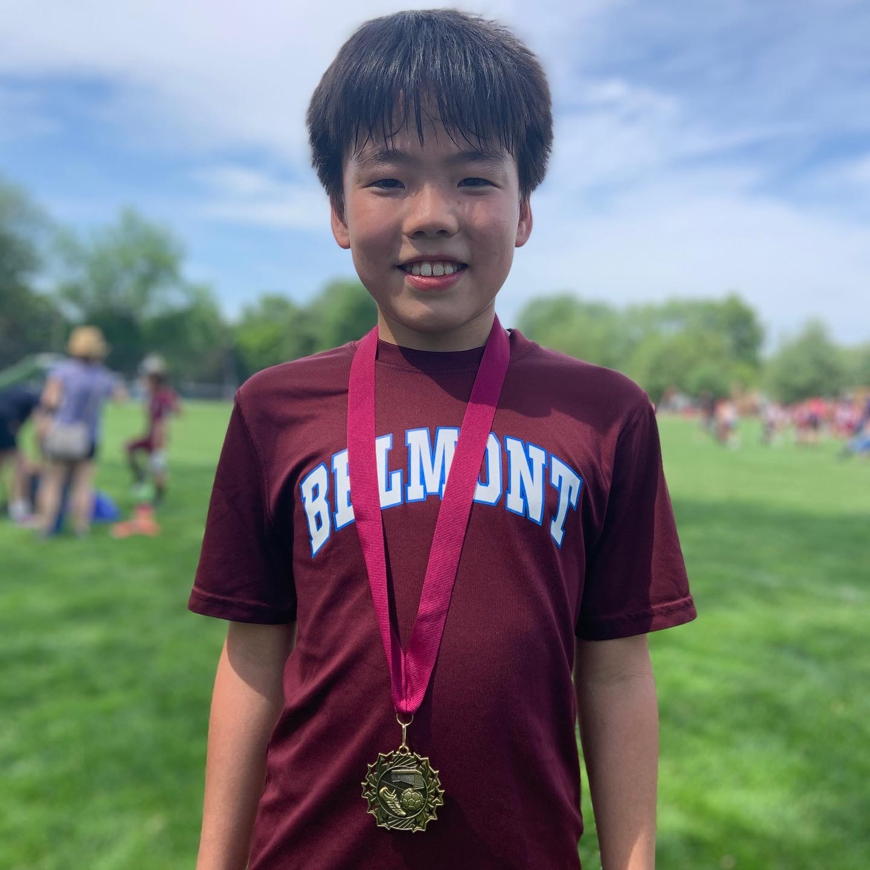
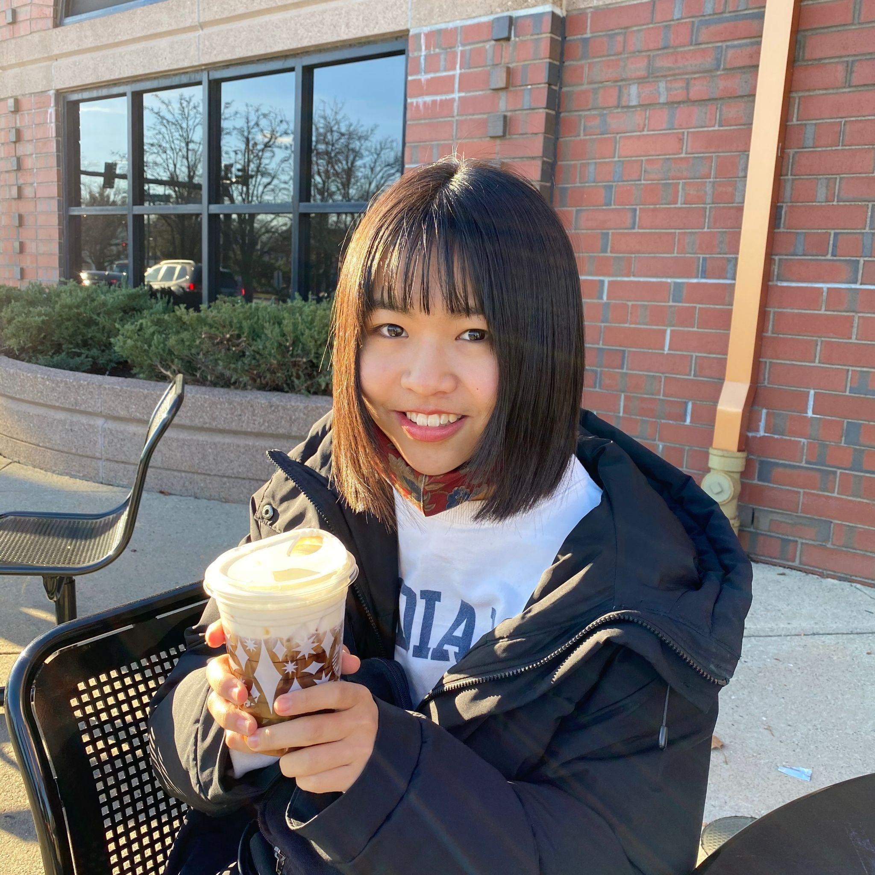
Team Members
Takeshi
Hanna
Yuto
Misaki
9th grader
at Belmont high
Love making origami or any other craft, table tennis, video games, watching youtube, and anime
Created the cardboard sword/ spear (in the icon), origami dragon, Infinity cube
6th grader Plays the piano, ukulele and tennis. Likes cooking, camping and Roblox. Runs 2 businesses.
Did a science project about “Miura fold,” which was used in a Japanese space mission.
5th grader at Chenery Middle School.
I love playing soccer, gaming and camping!
⚽️ 🎮 🏕
Supported fundraising for people in need of food by spreading Origami Challenge Project.
11th grader
at Belmont high
Love Track and field, genshin impact, anime, and reading,
Volunteered at binnovative.
Created origami christmas tree, flowers, paper toy
Notes:
H

Slide 3
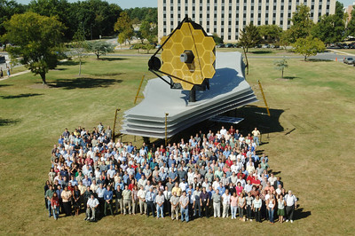
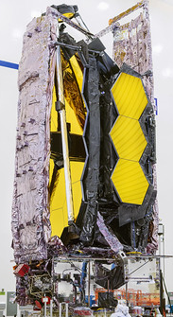
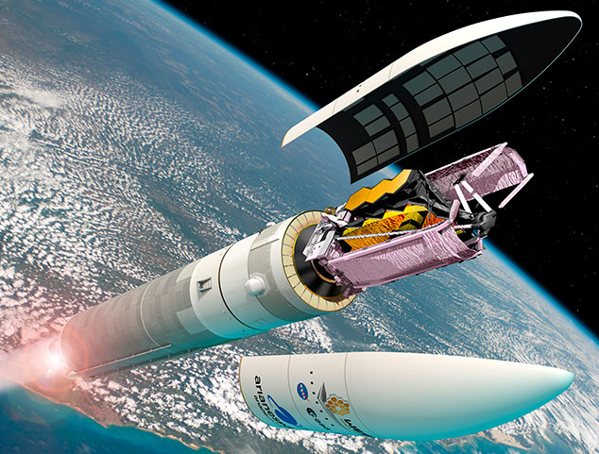
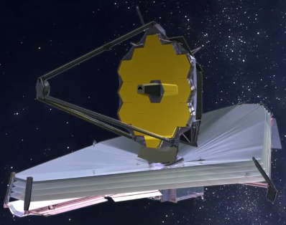
Our Background
We have diverse skills and experience.
Origami crafting
Internet-of-Things (IoT) programming with Raspberry Pi
We all are WOW-ed by how the James Webb Space Telescope (JWST) uses origami-like folding and unfolding.
Sources: https://www.flickr.com/photos/nasawebbtelescope/, https://svs.gsfc.nasa.gov/
Notes:
H

Slide 4
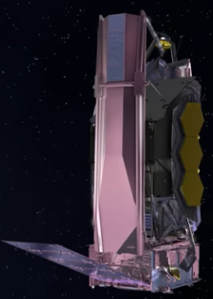
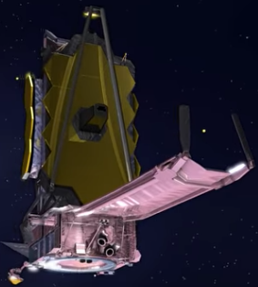
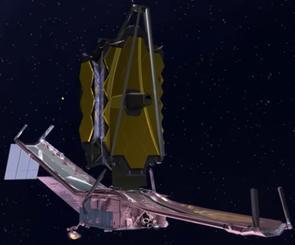
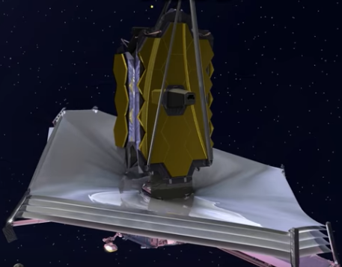
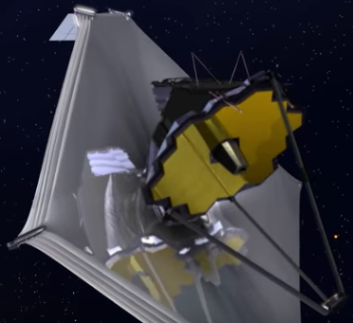
Our Project: Jack Jimmy in the Box
Our goal: Making computerized origami models for JWST
By the way, JWST’s “deployment” process looked like a Jack-in-the-box for us!
So, we decided to replace “Jack” with “Jimmy” for our project name, respecting Mr. Webb, who supported many science projects at NASA.
Sources: Northrop Grumman’s YouTube channel
Notes:
H

Slide 5
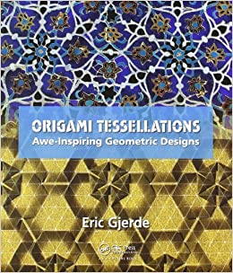
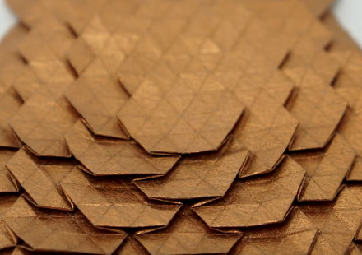
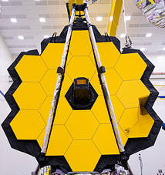
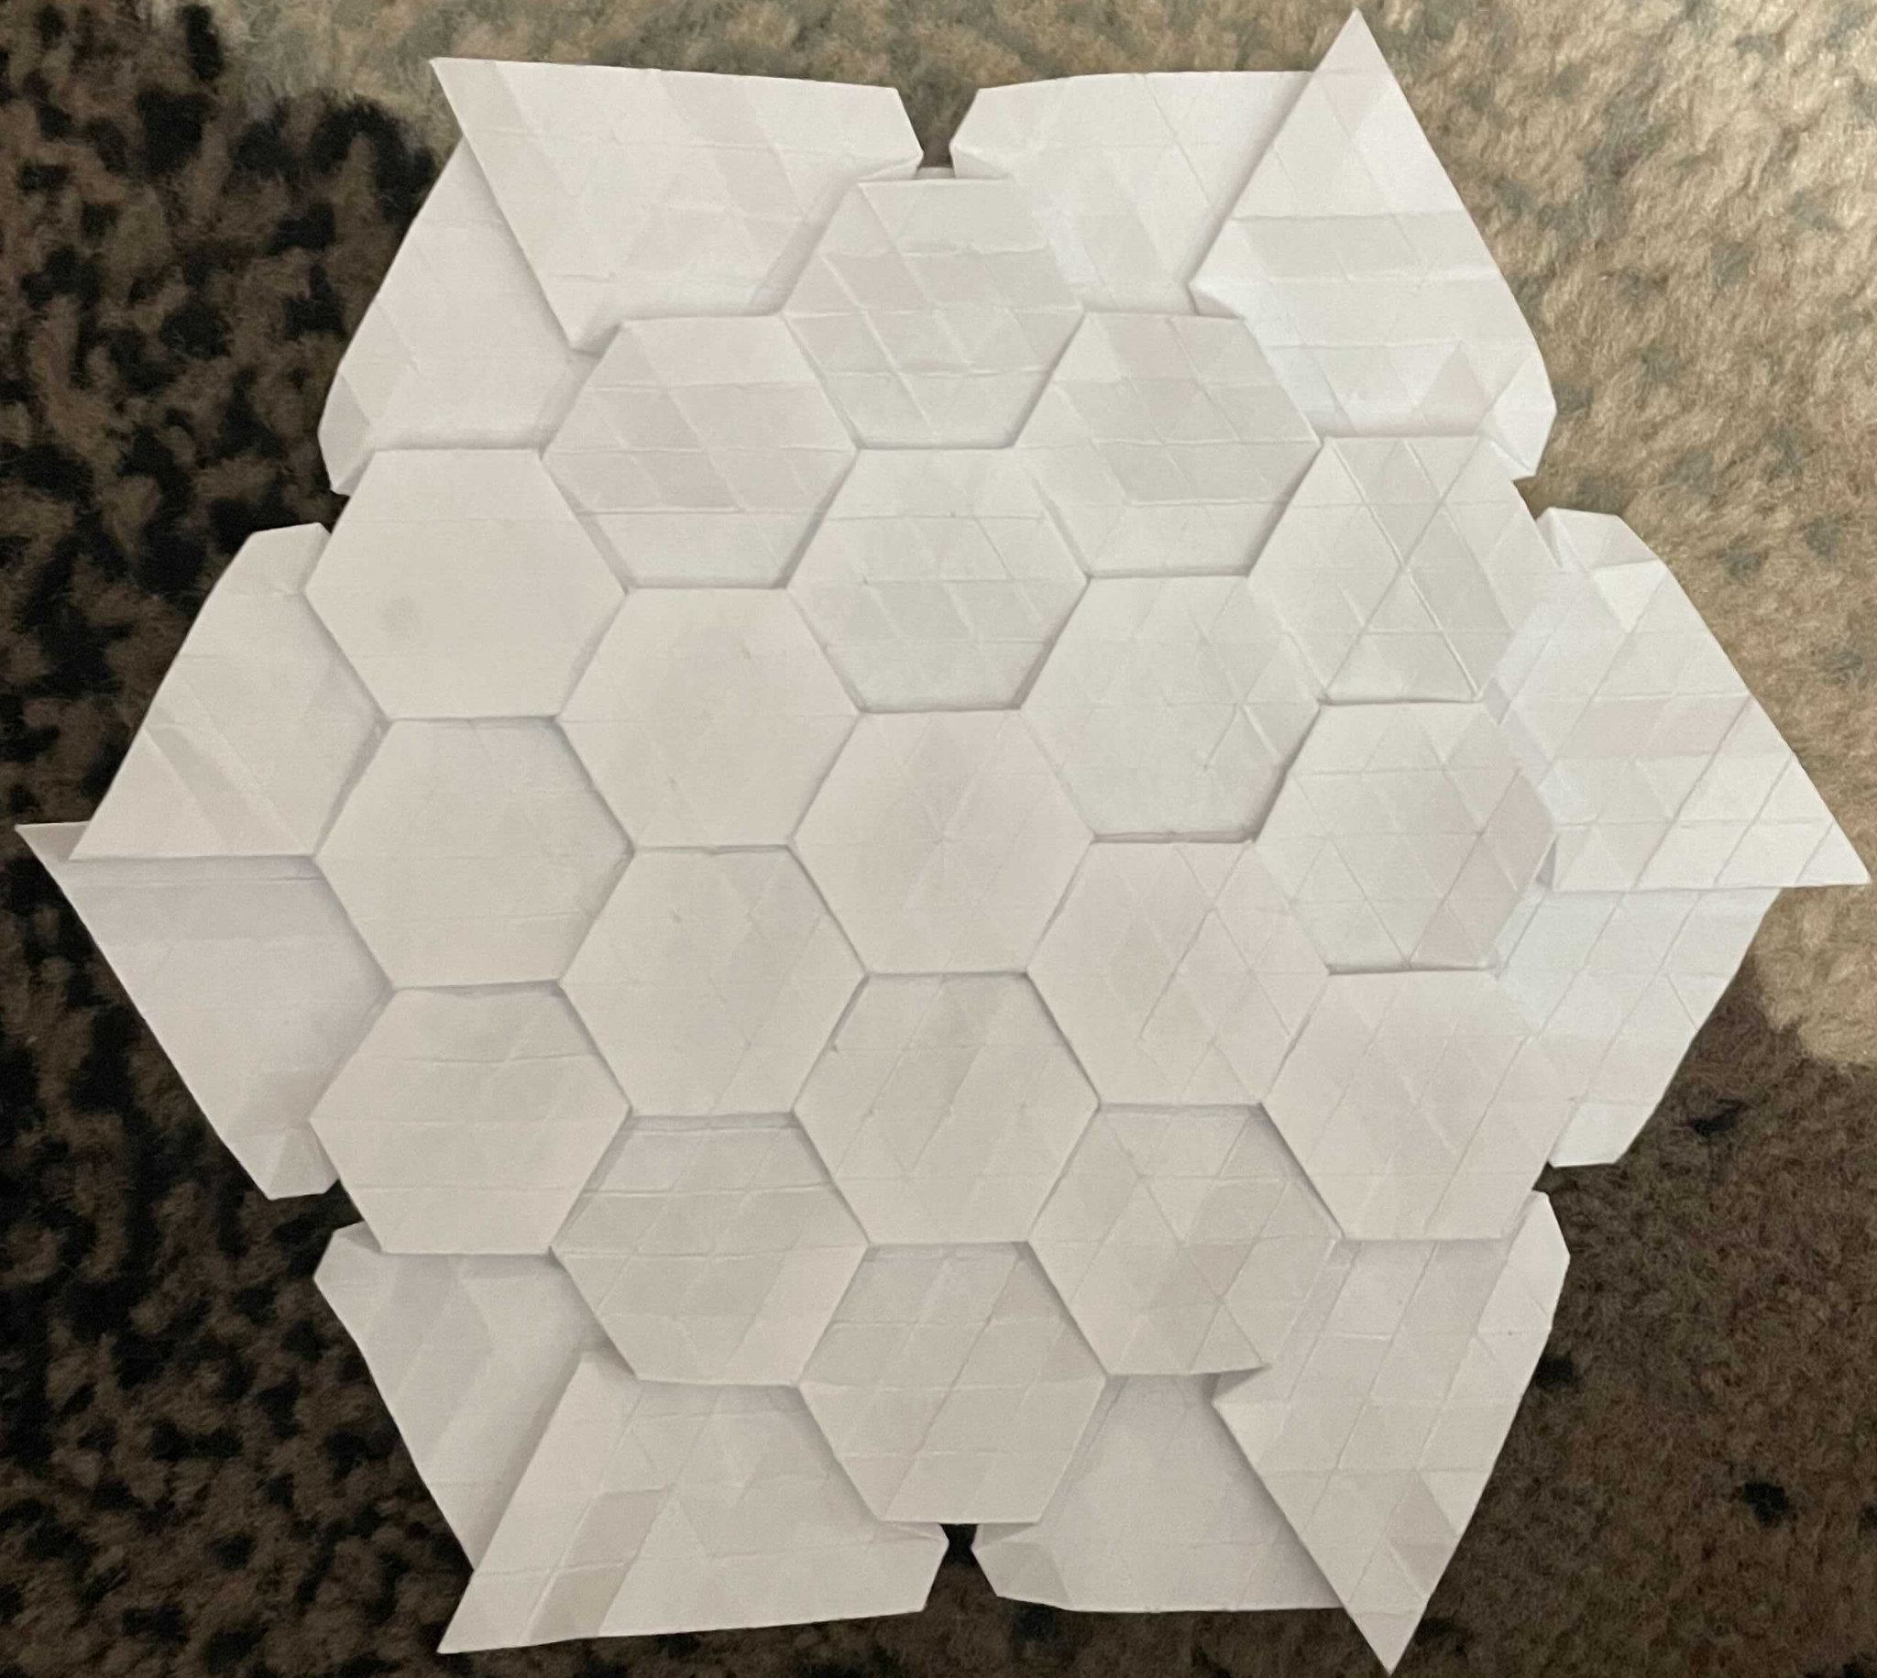
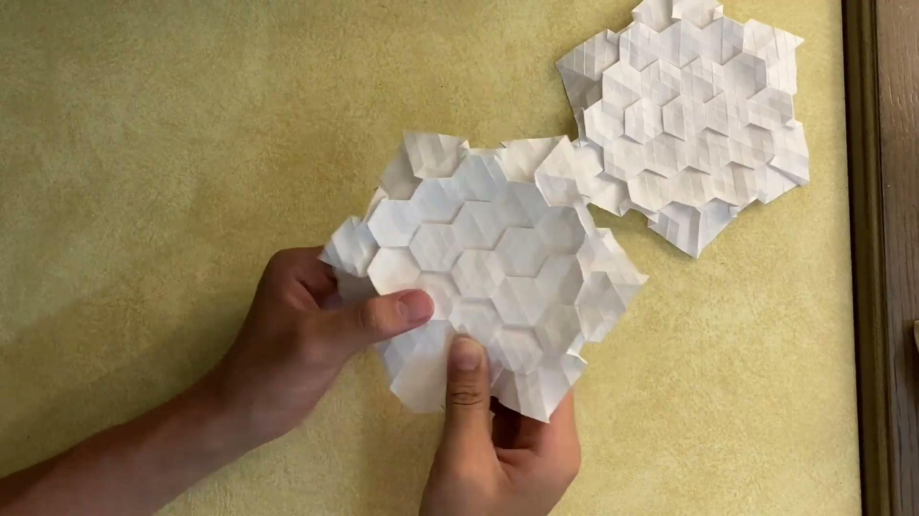
Origami Crafting for the Primary Mirror
Started with Eric Gjerde’s famous hexagonal tessellation to model JWST’s primary mirror.
Elegant, but not that similar because hexagons overlap to spread.
Customized the folding strategy to better model primary mirror.
Eric’s tessellation
JWST’s primary mirror
Our tessellation!!!
Demo Video
TAKESHI’s VIDEO HERE
Notes:
TM

Slide 6
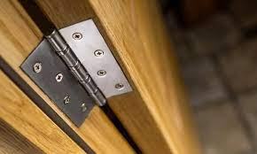
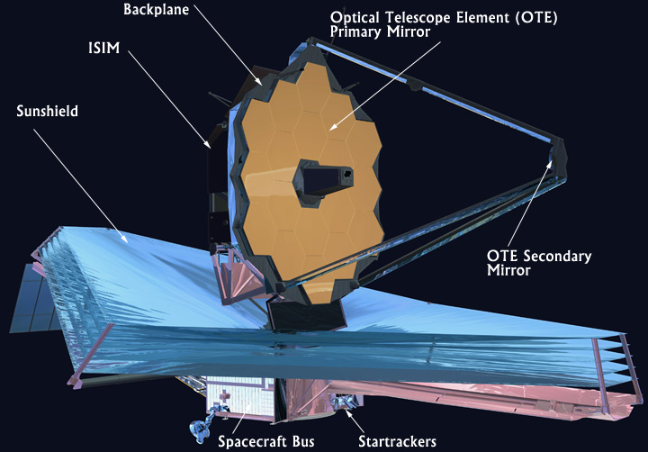
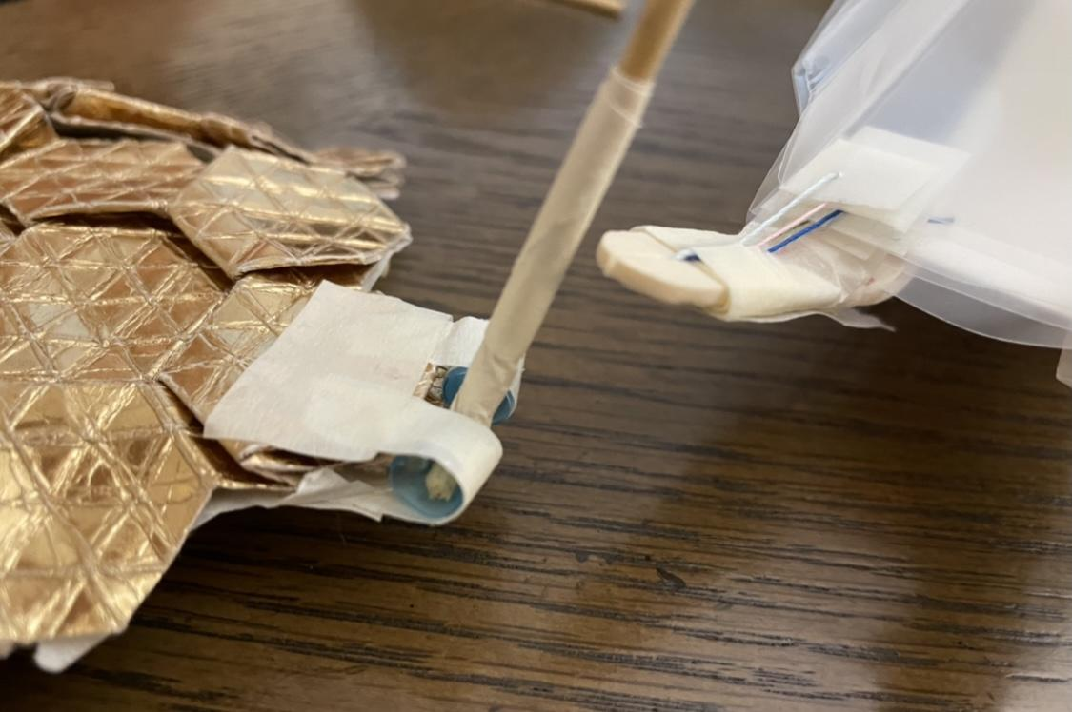
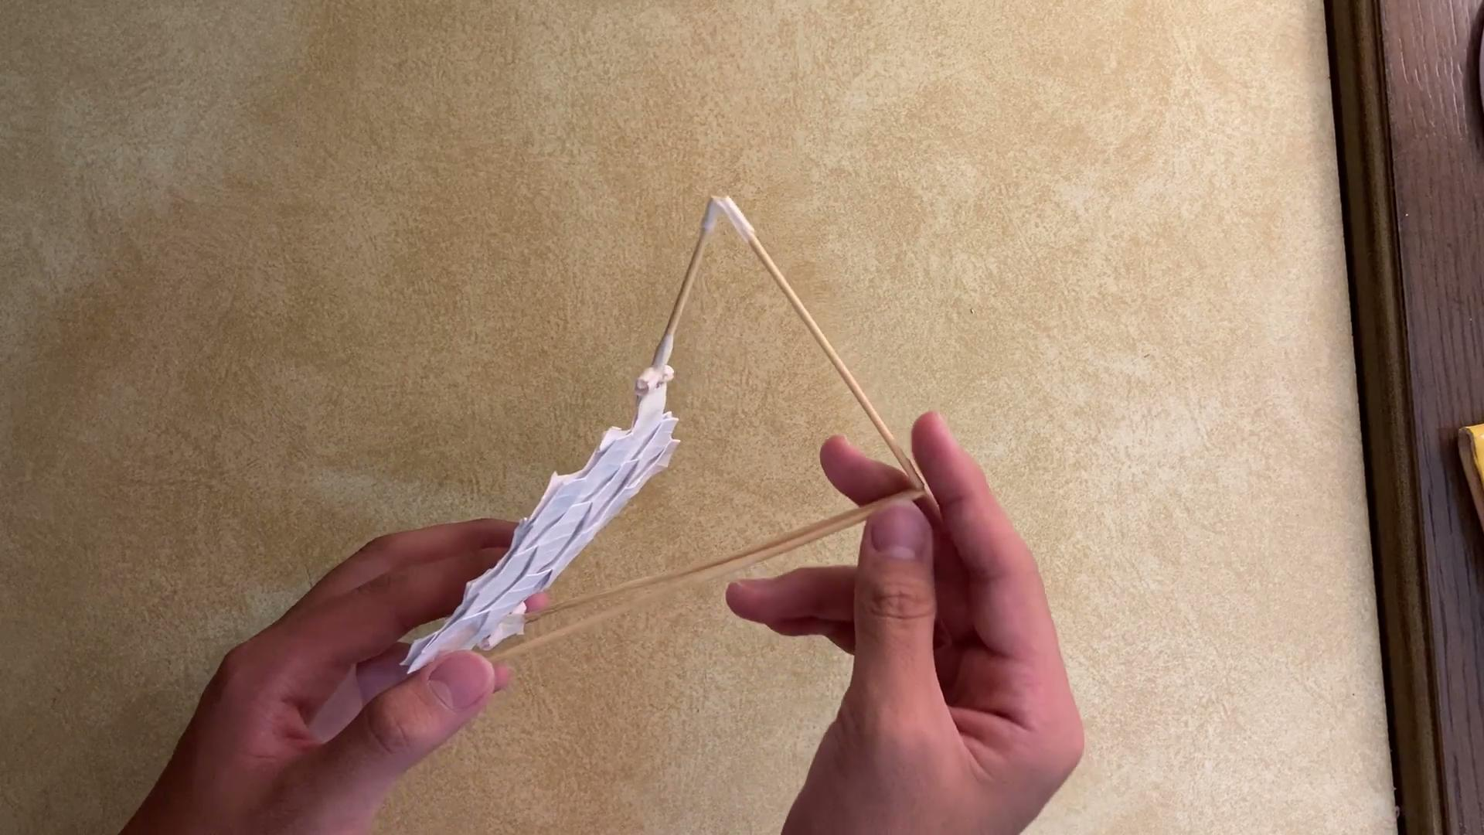
Origami Crafting for the Secondary Mirror
Modeled JWST's Secondary Mirror Support Structure (SMSS), which uses 3 arms to deploy the secondary mirror.
The arms are modeled with bamboo skewers, which are attached to the primary mirror with the hinges made with paper tape and plastic straws.
They fold toward the primary mirror and unfold to form a tripod
Door hinge
JWST’s secondary mirror
Our secondary mirror!!!
Notes:
TM

Slide 7
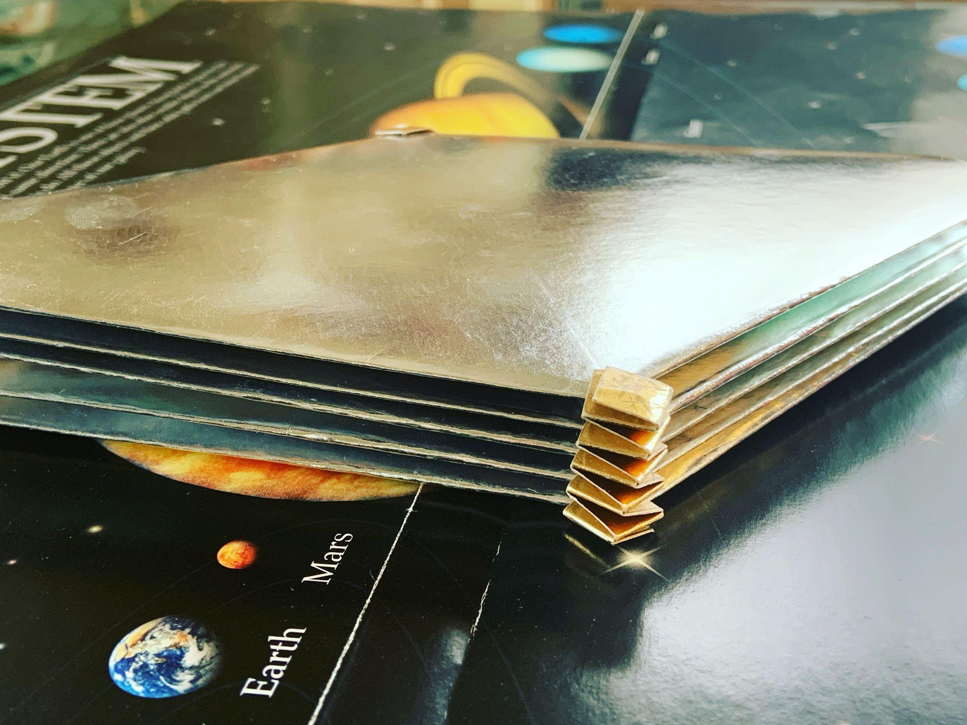
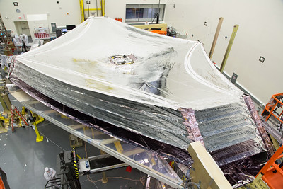
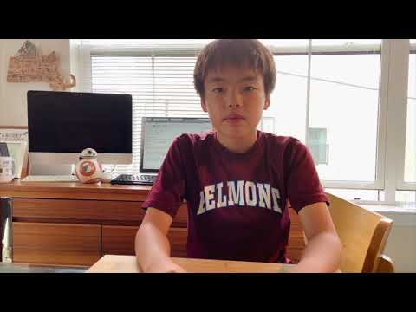
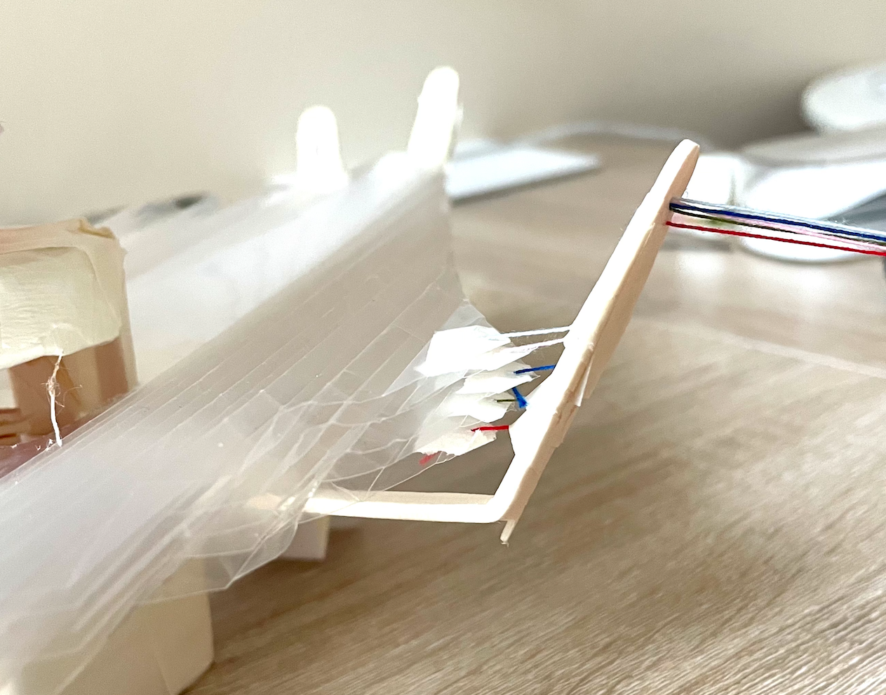
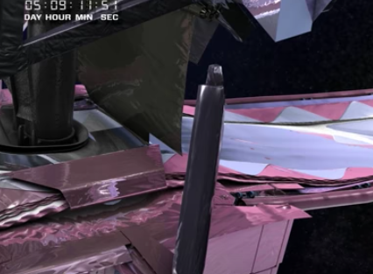
Origami Crafting for Sun Shields
Folded “long” hexagons and stacked them to model JWST’s sun shields.
Used sheet protectors as origami papers and slung five layers of them between foundation bars with strings.
JWST’s Sun Shields
How to make Our Sheild
Source: https://www.flickr.com/photos/nasawebbtelescope/
Notes:
Y

Slide 8
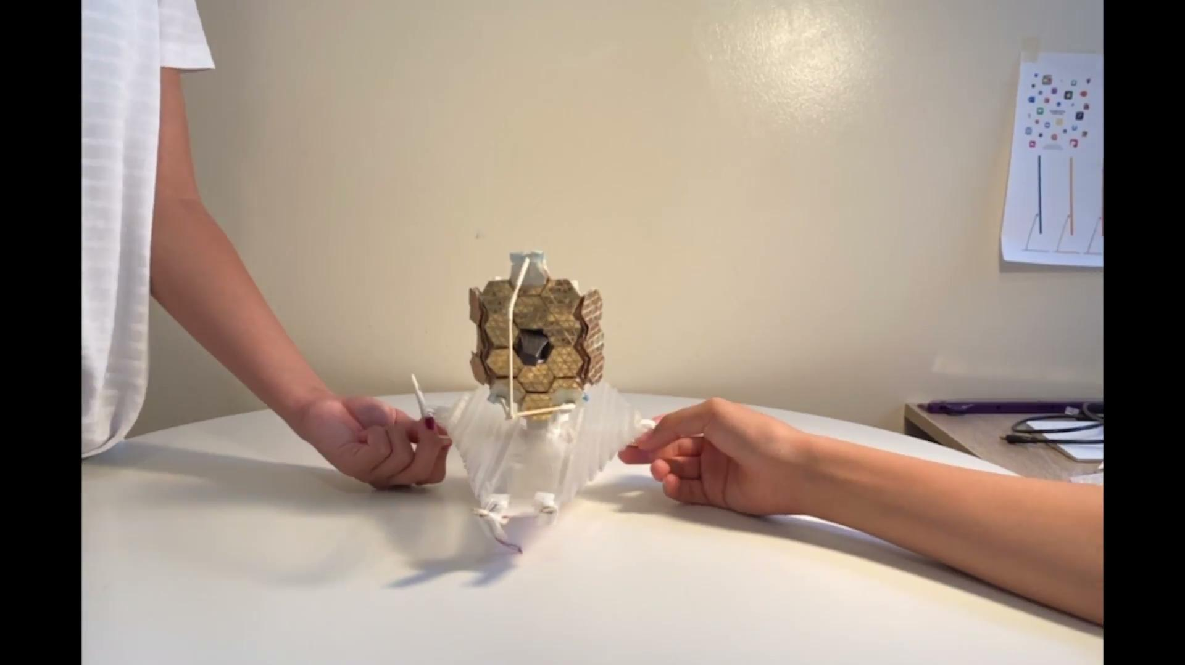
Our Prototype Model #1
By Takeshi & Misaki
The best thing while creating is to find out what’s related to thing in our life!
Notes:
TM

Slide 9
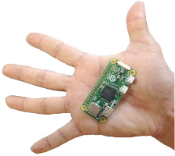
Turning Origami Crafts to Internet-of-Things (IoT) Devices
Wanted our telescope models to actively do something, not only being watched passively.
Integrated a Raspberry Pi (credit card sized computer) with origami crafts, so our model can do what the real telescope does.
Our computerized origami models
Take pictures with cameras
Keep track of the current location (latitude, longitude and elevation) with GPS receivers.
Notes:
Y

Slide 10



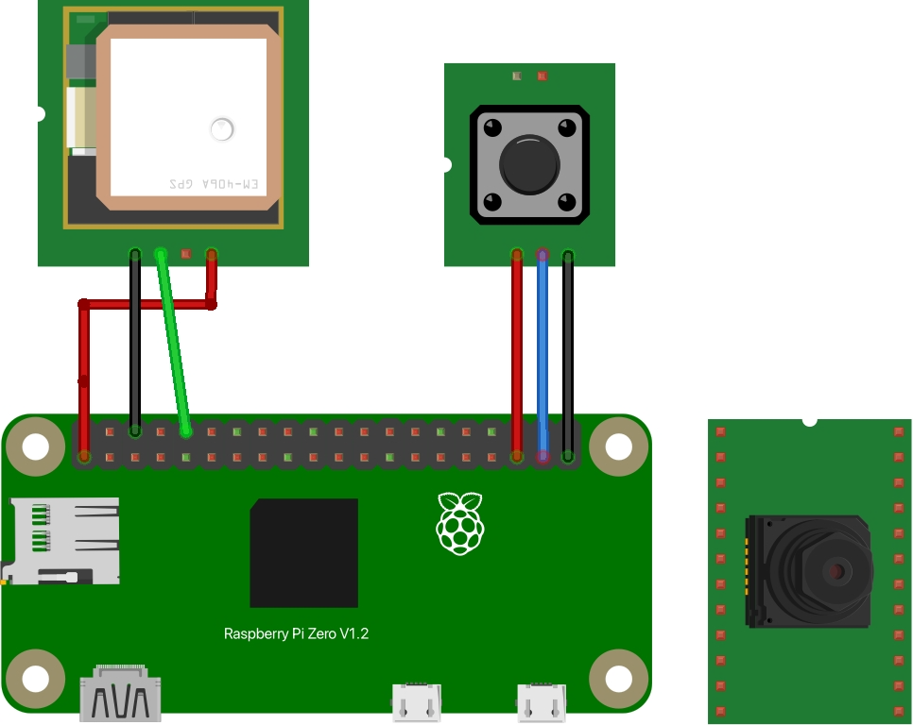



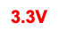
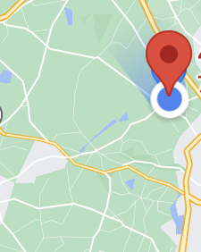
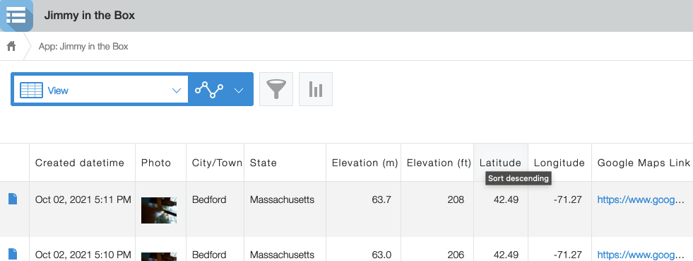
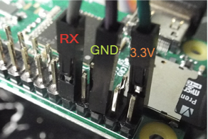
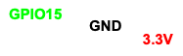
Circuits and Kintone App
3 circuits to wire up a camera, a push button and a GPS receiver.
A Kintone app to store data from a Raspi, convert meters to feet, and show a stored location on Google Maps.
Push
button
GPS Receiver
Camera
GPIO 19
Raspi
GPIO 26
Notes:
H

Slide 11
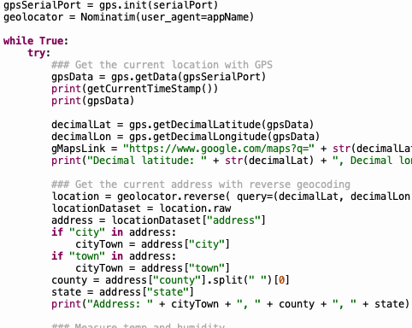
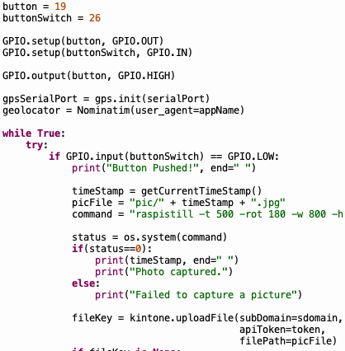
Python Apps
Periodically takes a picture, gets the current location (latitude, longitude and elevation) and uploads those data to Kintone.
Detects that a push button is pressed, takes a picture and upload it to Kintone.
Notes:
H

Slide 12
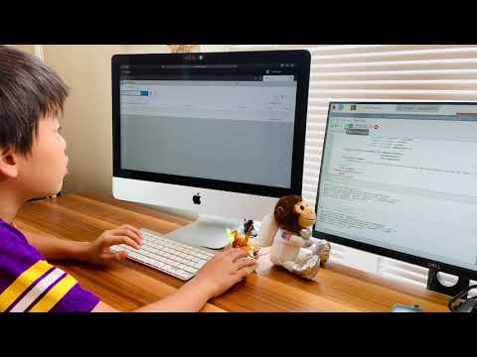
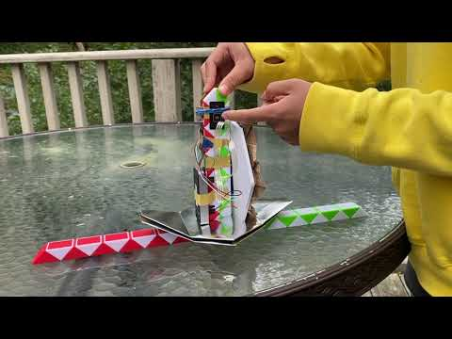
Our Prototype Models #2 and #3
Yuto’s Demo
Hanna’s Demo
Notes:
Y

Slide 13
Future Work
Set up a Web page with instruction videos, circuit diagrams and ready-to-run code to help anyone interested reproduce our origami crafts and IoT telescope models.
Come up with extra tessellation strategies for origami crafting.
Use extra sensors such as gyroscope and magnetometer to measure the telescope model’s attitude and direction.
Study how origami techniques can solve other challenges; Can we fold and unfold ISS modules, complex satellites or even houses?
Notes:
Y

Slide 14

THANK YOU!
Presented by JIMMY IN THE BOX:
Takeshi, Hanna, Yuto and Misaki

